Slide 1
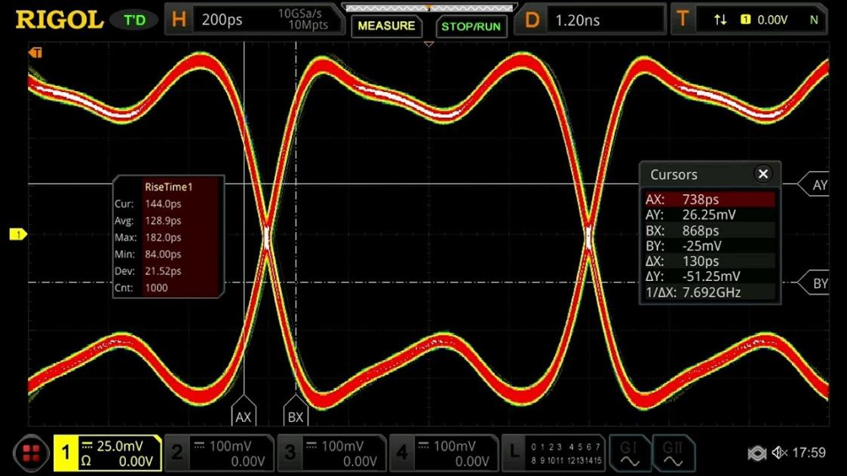
Advanced Serial Communications
January-2023

Slide 2
Concepts to Cover
Signal bandwidth
Logic Analyzer vs oscilloscope
High speed serial concepts (PCIe examples)
Advanced I2C
Advanced SPI
Long interconnect (wires)
Error detection
Long wires demo

Slide 3
What is the bandwidth of a signal?
<---1/100kHz = 10µs--->
<---1/100kHz = 10µs--->
100kHz
0ns rise time
100kHz
20ns rise time
100kHz
300ns rise time
100kHz
Sine wave

Slide 4
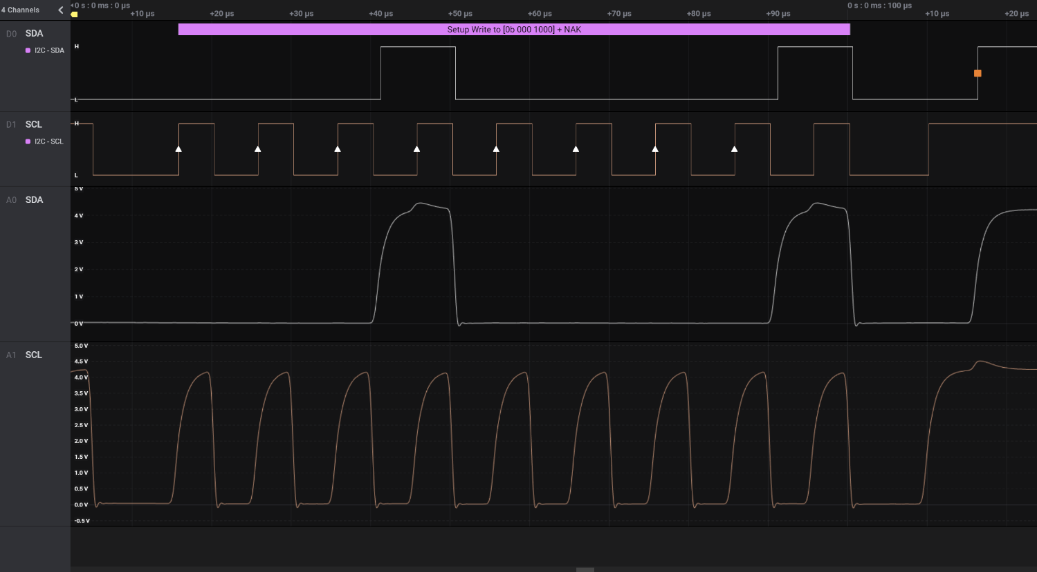
Logic Analyzer vs Oscilloscope

Slide 5

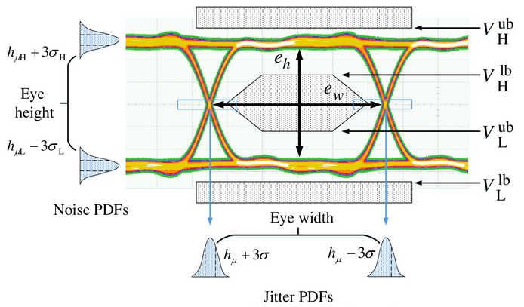
Eye Diagrams
Not particularly useful for the things we do

Slide 6
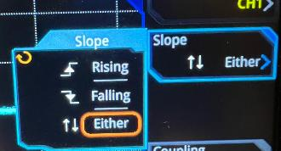
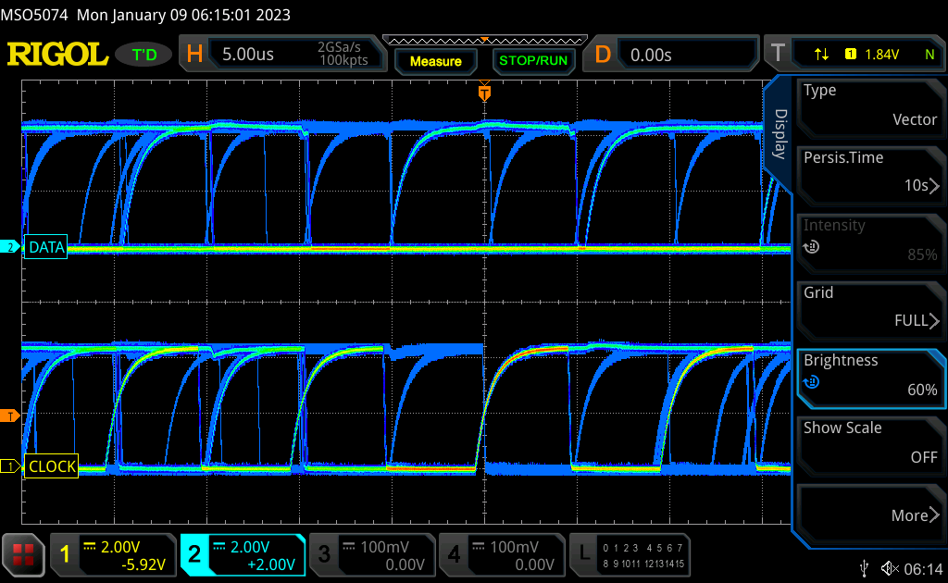
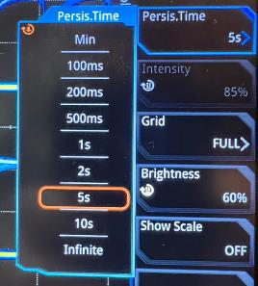
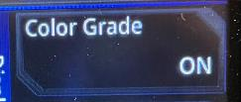
Eye Diagram of Arduino Nano I2C
Normally not very useful!
+/- Trigger
Persistence

Slide 7
High Speed : “The Channel”
Integrated circuit
Integrated circuit
Transmitter
PCB/Wires/
Connectors
Receiver
Receiver
PCB/Wires/
Connectors
Transmitter

Slide 8
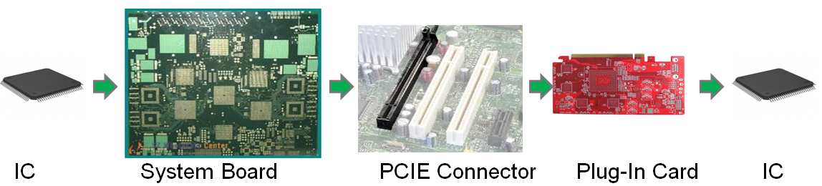
PCIE Channel
Integrated circuit
Integrated circuit
Transmitter
PCB/Wires/
Connectors
Receiver
Receiver
PCB/Wires/
Connectors
Transmitter

Slide 9

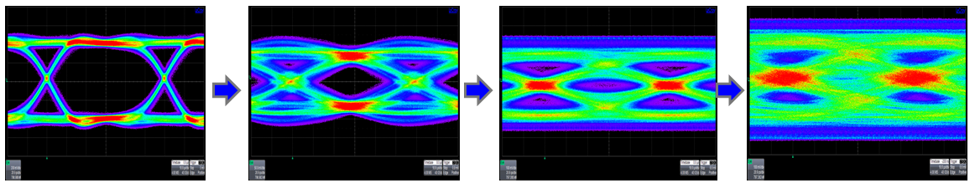
Signal Integrity

Slide 10
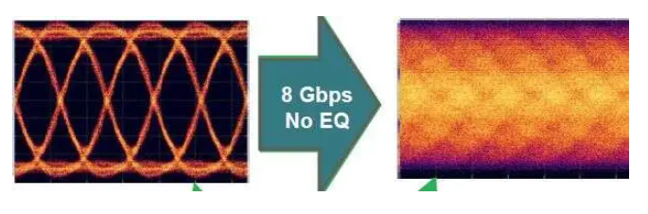
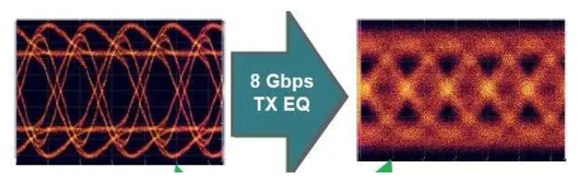
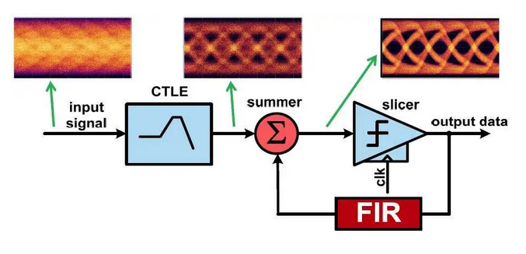
PCIe 3.0 Equalization
No EQ
Tx EQ
Rx EQ

Slide 11
Some PHY characteristics
Standard | Data Rate | Signaling Voltage
RS232 | 20kbps | +/-5V to +/-15V
I2C | 100kbps to 3.2Mpbs | 1.2V, 3.3V, 5V
SPI | >40Mbps | 1.2V, 3.3V, 5V
USB1 | 1.5/12Mbps | 0V / 3.3V
USB2 | 480Mbps | +/-400mv, diff
USB3.2 Gen 2x1 | 10Gbps | +/-400mV, diff
USB4 Gen 3x2 | 40Gbps | +/-400mV, diff
The large voltage swings and low speeds of RS232, I2C, SPI make them accessible
The high speeds of USB2-4 and PCIe require very expensive scopes ($3-5k) and logic analyzers (>$1k) and extensive signal integrity experience.

Slide 12
Takeaways
Architectures are kind of cool
There’s a lot of technology in that simple bus
Interested in playing with your own PCIe or high speed USB hardware?
Consider buying an FPGA or CPU card with the PHY taken care of

Slide 13
I2C – Advanced Topics
Multi-master
Clock synchronization
Arbitration
Clock stretching
Level translation
Pull-up resistor sizing

Slide 14
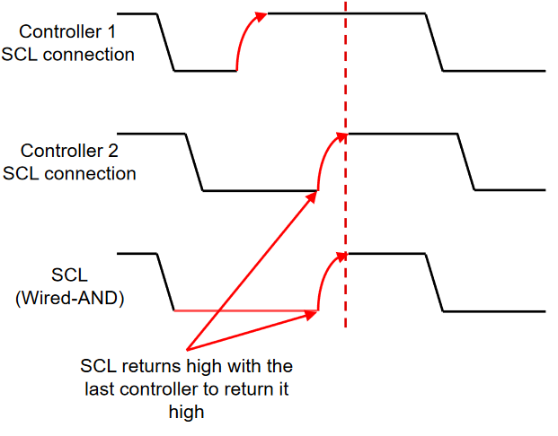
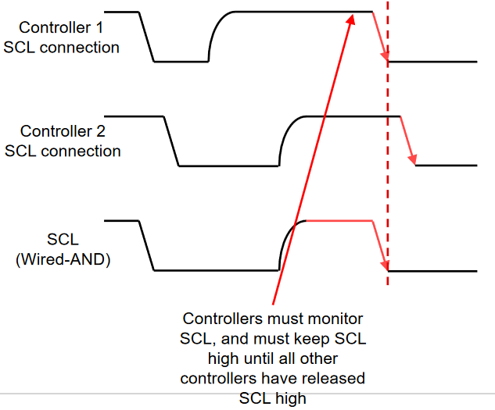
Clock Synchronization
Fastest master sets the high period
Slowest master sets the low period
All controllers monitor SCL to coordinate
Source: TI TIPL6104

Slide 15
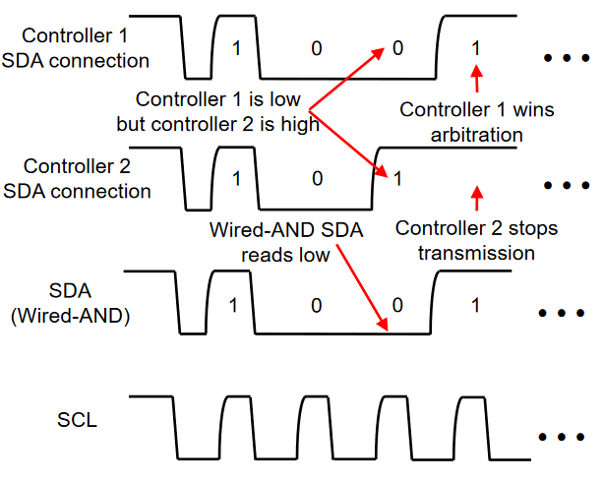
Arbitration
The first controller to send a low bit while the other sends a high bit, wins. The other stops.
Source: TI TIPL6104

Slide 16
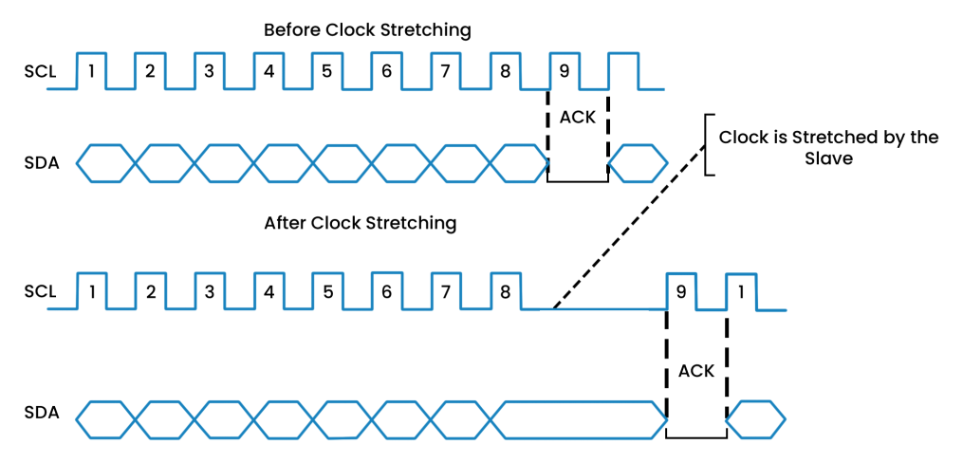
Clock Stretching
Slave can hold SCL low while it does things
Note: RPi don’t’ handle SCL stretching well
Not all slaves can stretch (or even have SCL drivers)
Arduino slave: wire.stretchClock(true)
Source: https://prodigytechno.com/i2c-clock-stretching/

Slide 17
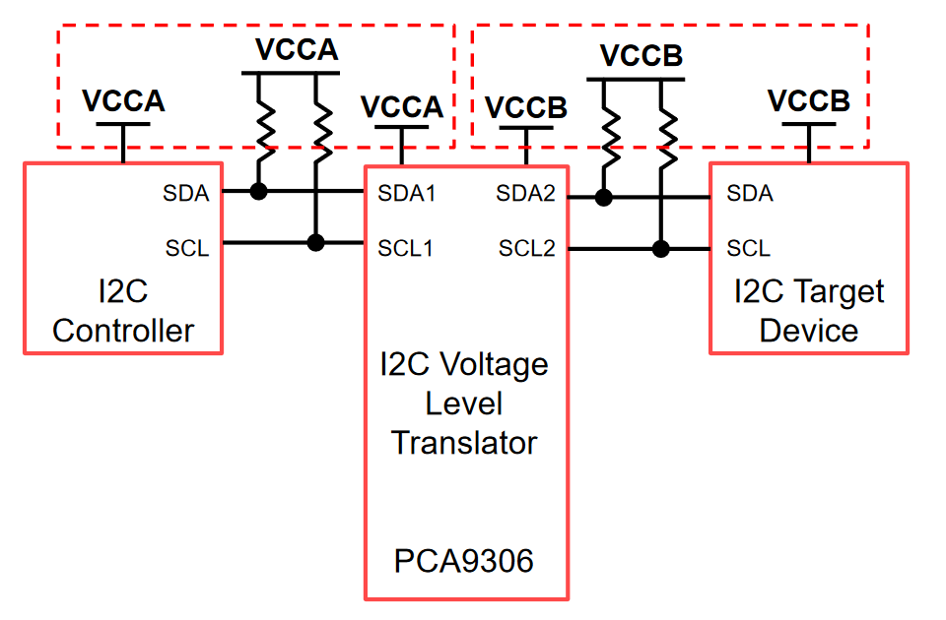
Level Translation

Slide 18
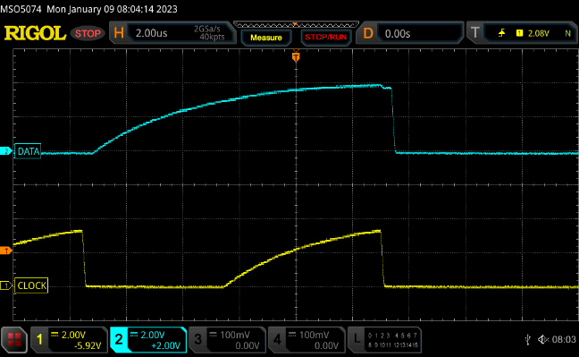
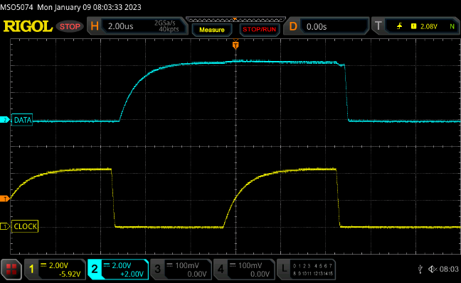
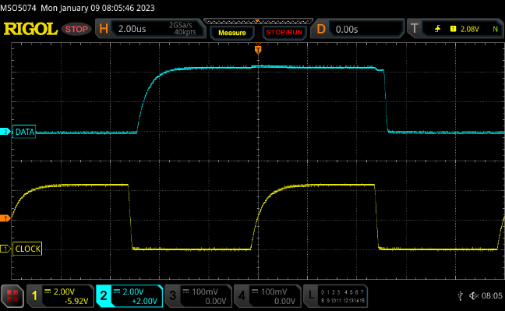
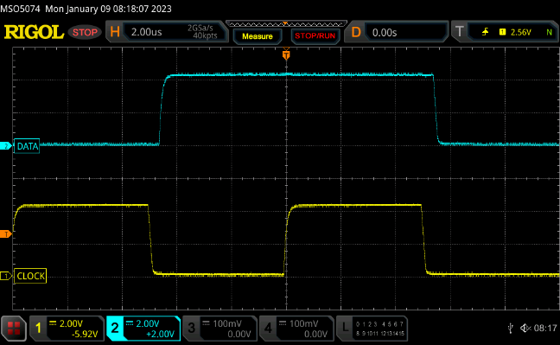
Resistor Sizing - ~10pF bus
20kΩ -30kΩ pull-up
10kΩ pull-up
4.7kΩ pull-up
1kΩ pull-up

Slide 19
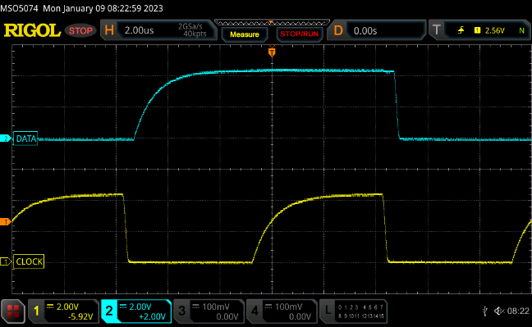
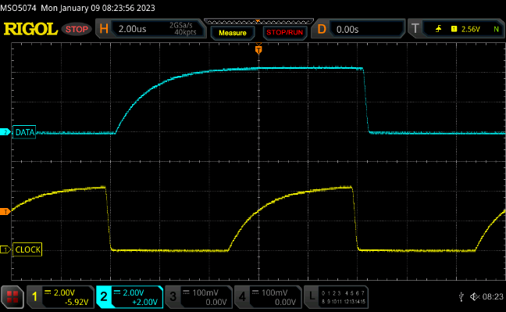
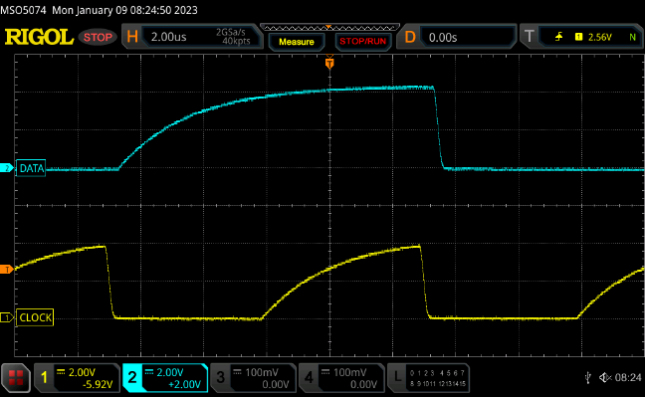
Resistor Sizing – 4.7kΩ pull-ups
10pF bus
110pF bus
230pF bus
480pF bus (!!!)

Slide 20
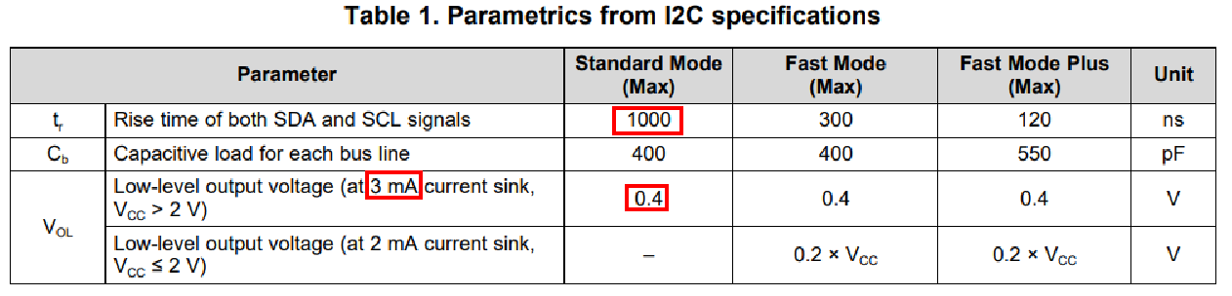

Pull-Up Resistor Sizing
4.7kΩ is a great general recommendation
Estimate bus capacitance
10pF per receiver (slave)
0.5pF / inch of PCB (FR4, 62mil thick, 25mil line width)
Pair of 20 gauge wires: 1pF / inch + inductive effects
$Rp,min= \frac{VCC−VOL,MAX}{IOL}$ = $\frac{5V −0.4V}{3mA}$ = 1.5kΩ
$Rp,max= \frac{trise}{0.847 x Cb}$ = $\frac{1000e−9}{0.847 ∗100pF}$ = 11.8kΩ

Slide 21
SPI – Advanced Topics
In some ways, simpler than I2C
No arbitration (only one master)
No pull-up resistors
No slave ACK – are you talking to a void?
Long wire issues:
Line drivers
Propagation delay
Clock feedback
Far-end terminations

Slide 22
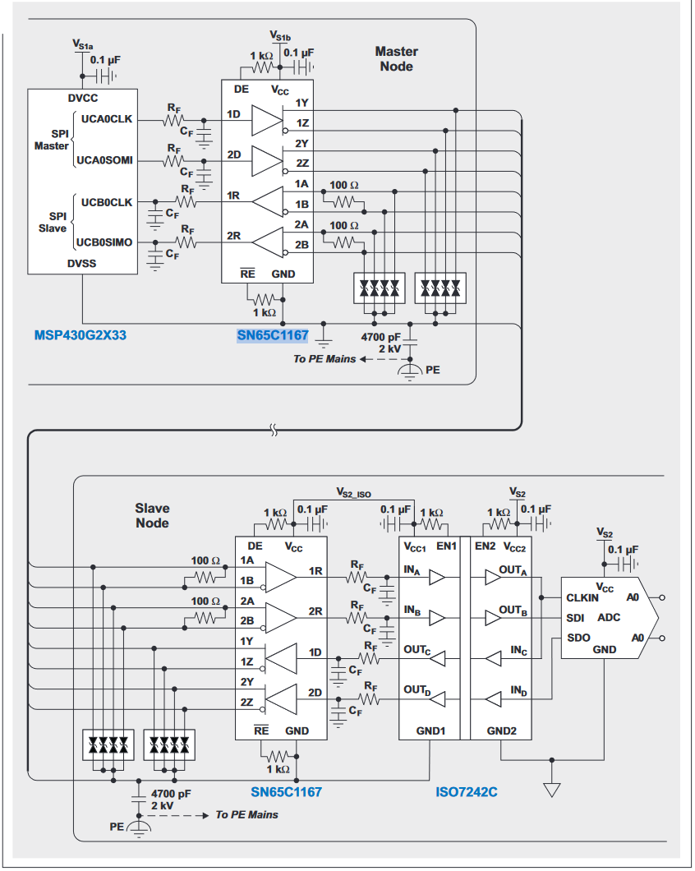
Line drivers
Propagation delay
Clock feedback
Far-end terminations
Source: https://www.ti.com/lit/an/slyt441/slyt441.pdf

Slide 23
Long Wires
Long interconnect may need attention
What is “long”?
Can cause a few issues
Ringing
Reflections
Rise time
Interference

Slide 24
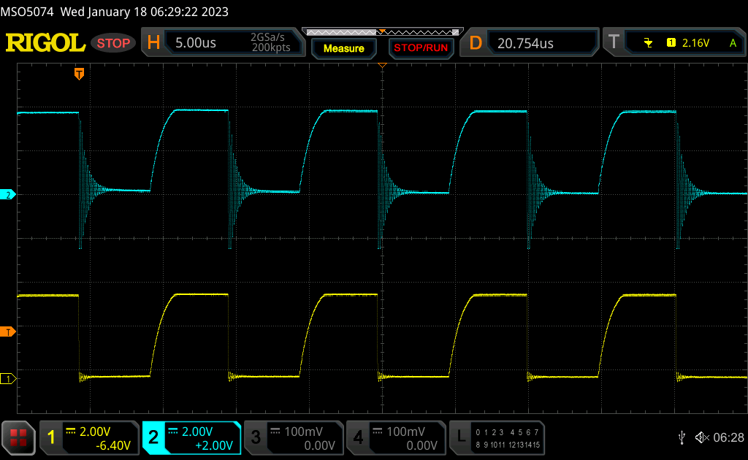
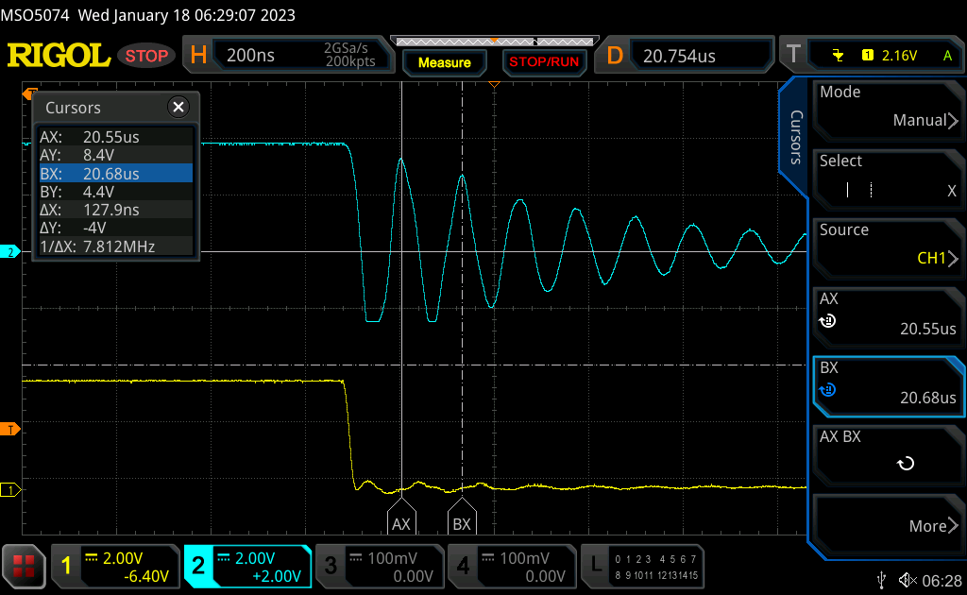
Ringing

Slide 25
Ringing
I2C output of a micro through 14’ of wire
~9µH of self inductance (All About Circuits)
Under-estimates loop inductance!
Assume 25pF capacitance
F_{resonant} = 1/(2*pi*sqrt(L*C)) = 1/(2*pi*sqrt(9e-6 * 25e-12)) = 10.6MHz
Close estimate to the 7.8MHz we measured
Ringing can be exacerbated by probing technique

Slide 26
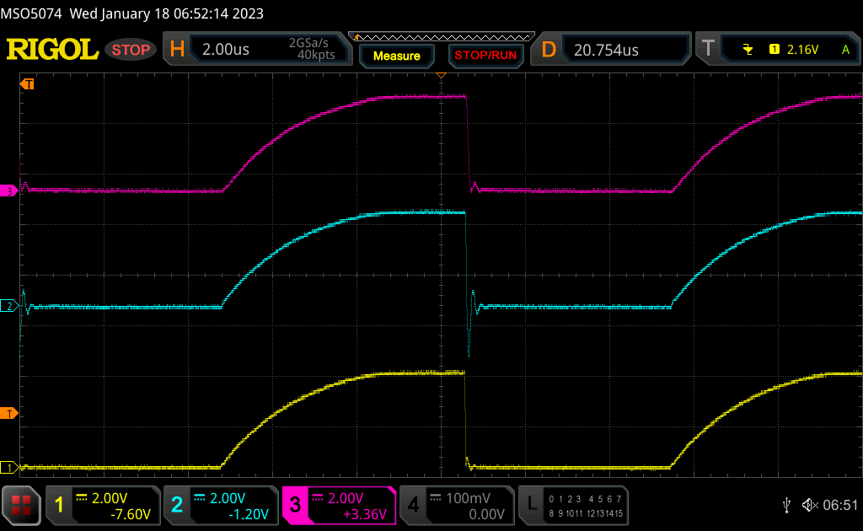
How to fix this?
Reduce I2C pull-up resistor values
Reduce data rate (*** trick question ***)
Shorten wire length
Reduce wire loop size
Add series-R, shunt-C at the end of the line
Clock after RC
(100Ω/100pF)
Clock before RC
Clock at source

Slide 27
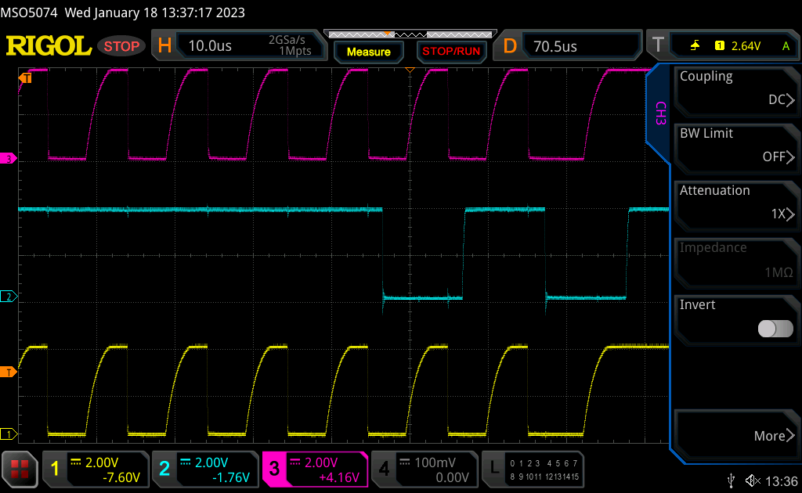
Yeah, this would work
Clock after RC
(50Ω/47pF)
Clock before RC
Clock at source

Slide 28
Error Detection
One simple method – CRC-8
Data (‘Ray’)
CRC-8
01010010 01010111 01111001
01111010
01010010 01010111 01111001 01111010
Not guaranteed – there are only 256 CRC values for all possible data inputs.
Cannot be done with typical SPI or I2C slaves, this is more useful if you write code on both ends
For anything other than hobby work – use correction

